Slide 1
Machine Learning
Lab

Slide 2
Contents
Linear regression
Logistic regression
Naive Bayes algorithm
k-NN algorithm
Decision tree algorithm
Support vector machine algorithm
Random forest algorithm

Slide 3
Linear Regression
Linear regression is a statistical method for modeling the relationship between a dependent variable (Y) and one or more independent variables (X).
Equation :
Y = mX + C
- Y is the dependent variable (output),
- X is the independent variable (input),
-m is the slope

Slide 4
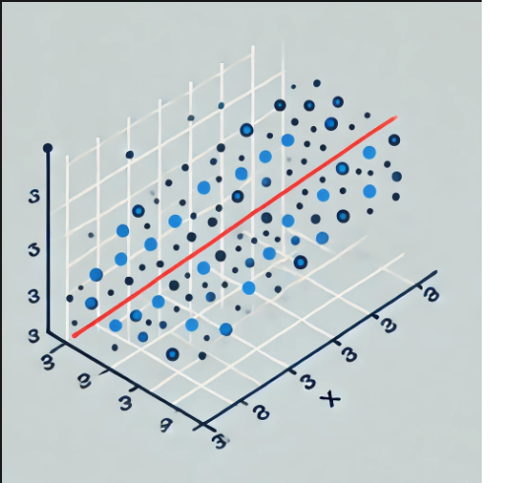
Figure

Slide 5
Linear Regression(con.)
Goal: To find the best-fitting line that minimizes the sum of squared residuals, improving prediction accuracy.
Application :
Stock market analysis
Disease progression prediction
Medical cost estimation
Student performance prediction

Slide 6

Logistic Regression
Definition: Logistic Regression is a classification algorithm used to predict binary outcomes (0 or 1) based on one or more independent variables.
The logistic function (sigmoid) is used to map predictions to probabilities:

Slide 7
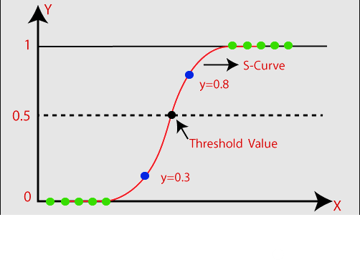
Figure

Slide 8
Logistic Regression(con.)
Goal :
The primary goal of logistic regression is to model the relationship between one or more independent variables and a binary or categorical dependent variable.
Application :
A patient having a disease (yes/no).
An email being spam (spam/not spam).
A customer churning (leave/stay)

Slide 9
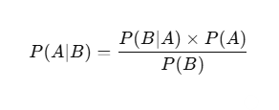
Naïve Bayes
Definition: Naive Bayes is a probabilistic machine learning algorithm used for classification tasks, based on Bayes' Theorem with the assumption that features are independent of each other.
Bayes' Theorem:
Where:
P(A|B): Probability of event A occurring given event B
P(B|A): Probability of event B occurring given event A
P(A): Prior probability of event A
P(B): Prior probability of event B

Slide 10
Naïve Bayes(con.)
Applications:
Spam detection
Sentiment analysis
Document classification
Fraud detection
Medical diagnosis

Slide 11
K-Nearest Neighbors (KNN)
K-Nearest Neighbors (KNN) is a supervised machine learning algorithm used for classification and regression. It classifies data points based on their proximity to other points.
Key Concept:
A data point is classified by a majority vote of its k nearest neighbors.
Distance metrics such as Euclidean, Manhattan, or Minkowski are used to determine proximity

Slide 12
KNN(con.)
Steps:
Choose the number of neighbors k.
Calculate distances between the point and all others.
Select k nearest neighbors.
Assign the class based on majority vote (classification) or average (regression).

Slide 13
KNN(con.)
Applications:
Handwritten digit recognition
Recommender systems
Customer segmentation
Image classification
Credit risk analysis

Slide 14
Decision Tree Algorithm
A Decision Tree is a supervised machine learning algorithm used for classification and regression tasks. It models decisions and their possible consequences in a tree-like structure.
Structure:
Root Node: Represents the entire dataset and splits on the best attribute.
Internal Nodes: Represent decision points based on features.
Leaf Nodes: Represent the final output (class labels or values).

Slide 15
Decision Tree(con.)
. Applications:
Customer behavior prediction
Medical diagnosis
Credit risk assessment
Fraud detection
Stock price prediction

Slide 16
Support Vector Machine (SVM) Algorithm
A supervised machine learning algorithm used for classification andregression tasks.
Core Idea: Finds the optimal hyperplane that separates data points of different classes with the maximum margin.
Key Concepts:
Hyperplane: A line (in 2D) or plane (in 3D) that divides the data space.
Support Vectors: Data points closest to the hyperplane, influencing its position and orientation.
Margin: The distance between the hyperplane and the nearest support vectors.

Slide 17
SVM(con.)
How SVM Works:
Uses kernel functions (linear, polynomial, radial basis function (RBF), etc.) to handle non-linear data.
Goal: Maximize the margin to improve classification accuracy.
Applications
Text Classification
Face Detection
Bioinformatics (e.g., protein classification)

Slide 18
Random Forest Algorithm
Random Forest is an ensemble learning algorithm used for classification and regression. It constructs multiple decision trees during training and combines their outputs for more accurate and stable predictions. Each tree is built using a random subset of data and features, and the final prediction is made by majority voting for classification or averaging for regression tasks.
Core Idea: Combines multiple decision trees to improve accuracy and reduce overfitting.

Slide 19
RN(con.)
Key Concepts
Decision Trees: Individual trees built on random subsets of data and features.
Ensemble Learning: Combines the predictions of multiple models.
Voting Mechanism:
Classification: Majority vote of trees.
Regression: Average of tree predictions.
How Random Forest Works
Randomly selects data samples and features for training each tree.
Aggregates results for final prediction.

Slide 20
Applications
Fraud Detection
Medical Diagnosis
Stock Market Prediction

Slide 21
Thank you.

